Slide 1
Ch : 4

Slide 2
Default Arguments To Virtual Functions :
As normal function, you can also have default arguments in virtual functions
you can pass default arguments to the virtual functions as well as pure virtual functions
The default arguments passed in virtual function will be valid for its derived class version also
All the rules for default argument function apply to the virtual functions with default arguments

Slide 3
Cont..
virtual return_type fun_name(arg=val,..)
{
//function body
}
We can have default argument in pure virtual function like :
virtual ret_type fun_nm(arg=val,…)=0;

Slide 4
Example :
#include<iostream.h>
#include<conio.h>
Class ABC
{
public:
virtual void test(int a, int b=0)
{
cout<<“Base Class”;
cout<<“A=“<<a;
cout<<“B=“<<b;
}
virtual void demo(int x=1)=0;
};
Class XYZ
{
public:
void test(int a, int b)
{
cout<<“Derived class”;
cout<<“A=“<<a;
cout<<“B=“<<b;
}
void demo(int x)
{
cout<<“X=“<<x;
}
};

Slide 5
Cont…
Void main()
{
ABC *p;
XYZ x;
p=&x;
cout<<“Using default arguments”;
p->test(11);
p->demo();
cout<<“Without using default arguments”;
p->test(11,22);
p->demo(111);
getch();
}

Slide 6
RTTI (Run Time Type Identification)
RTTI, as its name suggest, lets you determine the type of an object at runtime
The RTTI also allows you to check if an object is of a particular type or if two objects are of the same type
This can be done by using typeid operator, which determines the actual type of its arguments
The 3 main elements used in C++ RTTI :

Slide 7
Cont…
The dynamic_cast operator :
it is used for conversion between base class and derived class
The typeid operator :
it is used for identifying the actual type of an object
The type_info class :
class stores the type information returned by typeid operator

Slide 8
C++ Streams :
A stream represents a device on which input/output operations can be performed
We can also think the stream as the series of bytes
Generally the data flows from some source to destination through a medium.
The source and destination can be any device such as keyboard, mouse, display unit such as monitor or a file also
There are two types of streams :
Input stream and output stream

Slide 9
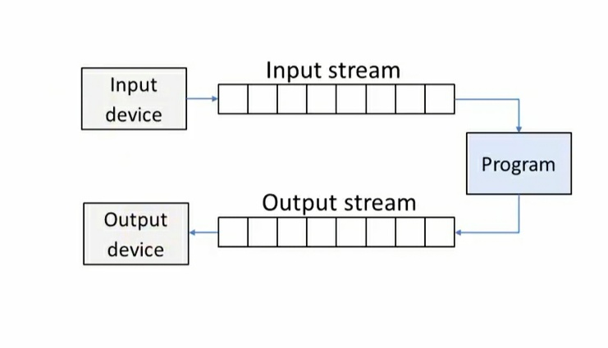
Cont…

Slide 10
Cont…
The input stream is the source stream that provides data to the program and the output stream is the destination that gets the data from the program
In short, the program fetches the data from the input stream and puts them into an output stream which is shown here.

Slide 11
C++ Stream Classes :
In C++ there are so many classes available to handle various input and output streams.
These classes are known as stream classes
The stream classes are contained in iostream.h headerfile so in order to use any of the stream classes you have to include this file
Here is an figure :

Slide 12
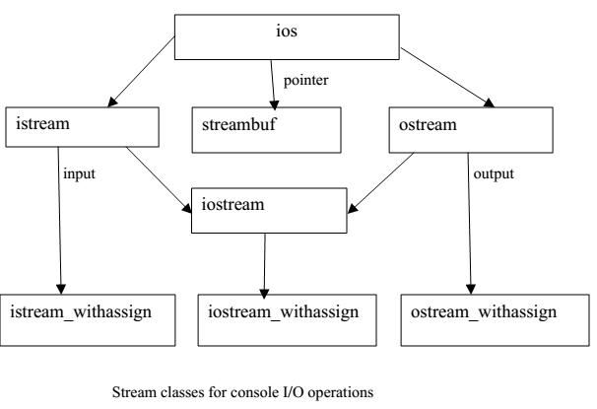
Cont..

Slide 13
Cont…
Here, ios class is the base class for all stream classes
The istream, ostream and streambuf classes directly derive from the ios class
Here, the inheritance is of hybrid type so that ios class is declared as virtual base class so that its properties are inherited only once in its derived class
The istream class provides functionalities for formatted and unformatted input operations and ostream class provides formatted and unformatted output operations

Slide 14
Cont…
The streambuf class is a template for all stream buffer classes that handles normal characters. It uses buffers to provide interface to physical devices
The iostream class, as its name suggests, provides the facilities for the input and output streams.
The istream_withassign, ostrem_withassign and iostream_withassign classes contains assignment operators to perform assignment operations.

Slide 15
Cont…
Ios | General input/output stream class that contains basic functionalities of input and output. Contains functions and constants for handling formatted I/O operations
Istream | It derives the ios class. Contains input functions such as get(), getline(), read()
Ostream | It also drives the ios class. Contains output functions such as put() and write()
Iostream | It derives properties of istream, ostream and ios class Contains all basic input output functions
Streambuf | It uses buffer to provide interface to physical input and output devices

Slide 16
Unformatted and Formatted I/O Operations :
Unformatted I/O Operations:
We use cin for unformatted input operations and cout for unformatted output operations. >> is used with cin to get input from keyboard.
cin>>a>>b>>c;
Here, three inputs from the keyboard can get and first input to a, second to b, and third to c.
Similarly, << is used with cout to print formatted output on screen. Cout<<“hello”;

Slide 17
The get() function :
get() is defined in istream class and is used get a single character as input from keyboard.
Syntax : void get(char *);
here the character is assigned to the character passed as argument
cin.get(a);
here a is the variable of char type. Syntax is : char get(void);
Example : a=cin.get();

Slide 18
The put() function :
The put() is defined in ostream class and is used to print a single character on the screen
We can print a line of text using put() number of times.
void put(char);
The character passed as argument is printed on the screen
cout.put(‘a’);
char c = ‘m’; char c=65;
cout.put(c);
We can pass integer value as argument to put(). Put() will treat numbers as ASCII value.

Slide 19
Example :
#include<iostream.h>
#include<conio.h>
Void main()
{
int count=0;
char c;
cout<<“Enter your text”;
while(c!=‘\n’)
{
cin.get(c);
count++;
cout.put(c);
}
cout<<“Total number of characters”<<count;
getch();
}

Slide 20
The getline() function :
The get() can get only one character at a time and put() can print only one character at a time.
The getline() is used to get more than one character as input.
Syntax : void getline(char*, size);
Here the first argument is character array where input is stored and size specifies the number of characters to be input.
The getline() will take input until you press enter key.
The getline() is used with cin object.

Slide 21
The write() function :
Unlike put(), you can use write() to print more than one characters on the screen.
write() is used with cout object
Syntax : void write(char*, size);
This function prints the number of characters specified by the size from the array passed as the first argument.

Slide 22
Example :
#include<iostream.h>
#include<conio.h>
Void main()
{
char a[10];
cin.getline(a,5);
cout<<endl;
cout.write(a,5);
getch();
}

Slide 23
Formatted I/O Operations :
In C++, we have so many useful features for formatting output such as :
Various functions and flags in ios class
Manipulators
The manipulators are defined in header file iomanip.h
To use these manipulators, we have to include <iomanip.h>

Slide 24
Function | Manipulator | Description
Width() | Setw() | Specifies the width of the output value
Precision() | Setprecision() | Specifies the size of fractional part for floating point number
Fill() | Setfill() | Specifies the fill character for unused portion of the value
Setf() | Setiosflags() | Specifies various flags for the output format such as right-justified, left-justified, decimal, octal, etc.
Unsetf() | Resetiosflags() | Reset the specified flags

Slide 25
Width() :
This function is used to specify the minimum width to occupy for the output value.
If the output value is of less than the specified width, the rest characters are filled with spaces.
The width() function is called using cout object.
cout.width(int width);
int a=123;
cout.width(5);
cout<<a;
The output will look like: _ _123

Slide 26
Cont…
The same way we can achieve using manipulator setw()
int a= 123;
cout<<setw(5)<<a;
You will get same output.

Slide 27
Precision() :
The precision() is used to specify the number of digits to printed after the decimal point for a floating point number
By default, the number of float variable displays 6 digits after the decimal point.
Syntax : cout.precision(int p);
float f= 1.23456;
cout.precision(2);
cout<<f;
This will print only 1.23

Slide 28
Cont…
Same way, manipulator will work
float f=1.2345;
cout<<setprecision(2)<<f;
The output will be same.

Slide 29
Fill() :
We know that when we use width() function to set width for our numbers, the unused portion s filled with spaces.
We can fill those unused portion with a character using the fill() or setfill() manipulator.
Syntax is : cout.fill(char ch);
Example :
int a=12345;
cout.width(10);
cout.fill(‘*’);
cout<<a;
Output will be like : *****12345
Setfill() manipulator : cout<<setw(10)<<setfill(‘*’)<<a;

Slide 30
Setf() :
This function is used to set various flags to format output.
We can set alignment of the text, scientific notation to numbers, base of numeric values such as decimal, octal, hexadecimal etc
Syntax is : cout.setf(flag, bit_field);
Here, flags and bit fields are defined in ios class

Slide 31
Flags and bit fields value for setf() function :
Bit field (arg2) | Flags (arg1) | Description
Ios::adjustfield | Ios::left | Aligns the text left justified
 | Ios::right | Aligns the text right justified
 | Ios::internal | Fills character between + and – sign. (also, 0 for octal, 0x for hexadecimal)
Ios::floatfield | Ios::scientific | Scientific notation. 123E+3
 | Ios::fixed | Fixed point notation. 123.456
Ios::basefield | Ios::dec | Decimal format number
 | Ios::oct | Octal number format
 | Ios::hex | Hexadecimal number format

Slide 32
Examples :
int a=15;
cout.setf(ios::hex,ios::basefield);
cout<<a;
output will be A as equivalent to 15 in hexa
float f=12.34;
cout.setf(ios::scientific,ios::floatfield);
cout<<f;
output will be 1.234e+01

Slide 33
Some Other Flags :
Flag | Description
Ios::showbase | Show base of numeric values. 0 for octal, 0x for hexadecimal
Ios::showpos | Show positive. Show + sign for positive numbers
Ios::showpoint | Show point. Shows number with points. Like, 12 as 12.00
Ios::uppercase | Characters of hexadecimal notation and scientific notations are displayed in capital latters. 1.234e+01 as 1.234E+01.

Slide 34
Unsetf() :
The unsetf() function is used to clear the effect of a flag set before.
Syntax : cout.unsetf(flag);
Example : float f=12.34;
cout.setf(ios::scientific,ios::floatfield);
cout<<f;
cout.unsetf(ios::scientific);
cout<<f;
This will print the number in default format.
resetiosflags() manipulator works same.
cout.resetiosflags(ios::scientic)<<f;

Slide 35
Example :
orally
cout.width(5);
cout.precision(2)
Cout.width(10)
Cout.fill(‘*’)
Cout.setf(ios::left,ios::adjustfield)
Cout.setf(ios::internal,ios::adjustfield)
Cout.setf(ios::right,ios::adjustfield)
Cout.sef(ios::scientific,ios::floatfield)
Cout.setf(ios::uppercase)
Cout.setf(ios::basefield,ios::oct)
Cout.setf(ios::basefield,ios::hex)

